Slide 1


Cincinnati Retirement System
2025 Update
1

Slide 2


CINCINNATI RETIREMENT SYSTEM
→Welcome to CRS!
Our Mission: Help members retire successfully
  Assure pension and healthcare benefits for current and future retirees
  Assist and support CRS members in achieving a successful retirement
  Assure CRS transparency and accessibility for all stakeholders
Established in 1931; pre-dates Social Security
  Public employees in OH do not participate in Social Security
  CRS members can be eligible for Social Security through a previous employer
2

Slide 3
CINCINNATI RETIREMENT SYSTEM
→CRS Snapshot
As of 12/31/2024:
  Retirees: 4,138
  Actives: 4,423 (FT, PT, DROP)
  Total assets = $2.3B
  Unfunded Actuarial Liability = $846mm
  Funded ratio (pension trust) = 68.3%
  Funded ratio (health trust) = 154.98%
      Federal law prohibits transfer of monies out of Health Trust
3

Slide 4
CINCINNATI RETIREMENT SYSTEM
→Governance
Board of Trustees (4yr terms)
  4 appointed by Mayor
  3 elected by retirees
  2 elected by active employees
  Board has exclusive authority over trusts
  Meets first Thursday of each month
Governed by:
  Collaborative Settlement Agreement-2016
  CMC Ch. 203; Admin Code Art. XV
  Board Rules and Policies
4

Slide 5
CINCINNATI RETIREMENT SYSTEM
→Staffing
5

Slide 6
CINCINNATI RETIREMENT SYSTEM
→CRS Operations
What We Do:
  Process retirement applications
  Enroll new members
  Process Return of Contributions
  Process Death Benefits
  Process 457 Plan enrollments
  Process Retiree Healthcare Open Enrollment and Medicare Transitions
  Process Service Purchases
  Member Education and Customer Service
6

Slide 7
CINCINNATI RETIREMENT SYSTEM
→CRS Benefits
6 different types of retirement benefits:
  Monthly Pension Benefit
  Retiree Healthcare
  Deferred Retirement Option Plan
  Disability Retirement Benefits
  Survivor Benefits
  Deferred Compensation (457 Plan)
Eligibility for each type of benefit differs
7

Slide 8
CINCINNATI RETIREMENT SYSTEM
→Monthly Pension Benefit
CRS provides a “Defined Benefit” pension
  “Defined Benefit” means a formula-based monthly payment for the rest of your life
    Employer assumes financial risk
  Different than “Defined Contribution” which provides a lump sum at retirement
    Employee assumes financial risk
Retirement
Decade 1, 120 payments
At death: Optionee receive payment
Decade 2, 120 payments
Decade …., x payments
Retirement
Decade 1
At death: Inheritance
Decade 2
Decade ….
8

Slide 9

CINCINNATI RETIREMENT SYSTEM
→Funding Defined Benefit Plans
Contributions + Investments =
  Benefits + Expenses
Actuaries Seek to Predict:
  The CRS Board approves the actuary and actuarial assumptions
  Rate of investment return, retirement age, years of service, salary increases, mortality, administrative cost, inflation, healthcare cost increases
  Actuaries make good faith professional estimates
    But no one has a crystal ball!
9

Slide 10
CINCINNATI RETIREMENT SYSTEM
→Funding Benefits: Investments
CRS Board has adopted an Investment Policy Statement (revised, 2025)
  Preserve safety of principal
  Adopts prudent investor rule
  Diversify investments in different asset classes with strategic asset allocation
  Staff and Consultant: Marquette Assocs.
    Selects and manages investments according to Board asset allocation
10

Slide 11
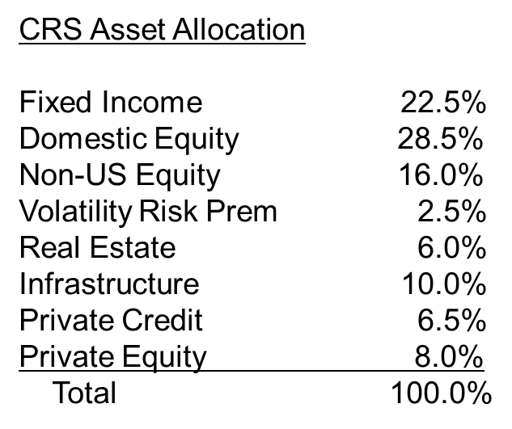
CINCINNATI RETIREMENT SYSTEM
→Funding Benefits: Investments
11

Slide 12
CINCINNATI RETIREMENT SYSTEM
→Funding Benefits: Investments
Active Investing
    Manager seeks to beat benchmark through proprietary analysis and selection of investments
    Can be costly; results vary—can beat the benchmark some of the time; difficult to do all the time
Passive Investing
    Use index funds to track the benchmark
    Very inexpensive compared to active investment
Alternatives
  Investment in illiquid markets of equity, credit and real assets
12

Slide 13
CINCINNATI RETIREMENT SYSTEM
→Funding Benefits: Investments
13

Slide 14

CINCINNATI RETIREMENT SYSTEM
→Improvements to Plan over 3 Years
14

Slide 15
CINCINNATI RETIREMENT SYSTEM
→Accomplishment and Goals at CRS
Healthcare survey in 2025, like in 2023
Healthcare funding policy finalized in 2024
Add Member Counselor 1Q 2024
Publish a Member Handbook in 2025
Publish a Retiree Handbook in 2025
1-on-1 retirement counseling mtgs 2024/5
Regular Retirement 101 trainings for actives
Open MemberDirect portal for Retirees in 2024
  Our mission is helping our members have a successful retirement!!
15

Slide 16
CINCINNATI RETIREMENT SYSTEM
CRS website is continually updated
  Board meeting packets, minutes, agenda, financial reports, investment and actuarial reports, resources, newsletters, updates governance documents (CSA, Muni Code, Board rules and polices). Click here for CRS.
16

